Slide 1

N-Body Simulation
Fabian Hölzl, Nicolas Sierra Manrique
Technische Universität München
Garching, 03. July 2025

Slide 2
Outline
Introduction to N-Body Problems
Physics for Stellar Systems
Interaction Methods
Position Integration Methods
Nvidia’s N-Body Algorithm
Code Samples
Performance
Visual Examples

Slide 3
Introduction to N-Body Problems
-multiple bodies interacting with each other based on some physical law -> forces between each particle
-> e.g. gravitation or molecular dynamics (dna/protein interactions, protein folding)

Slide 4
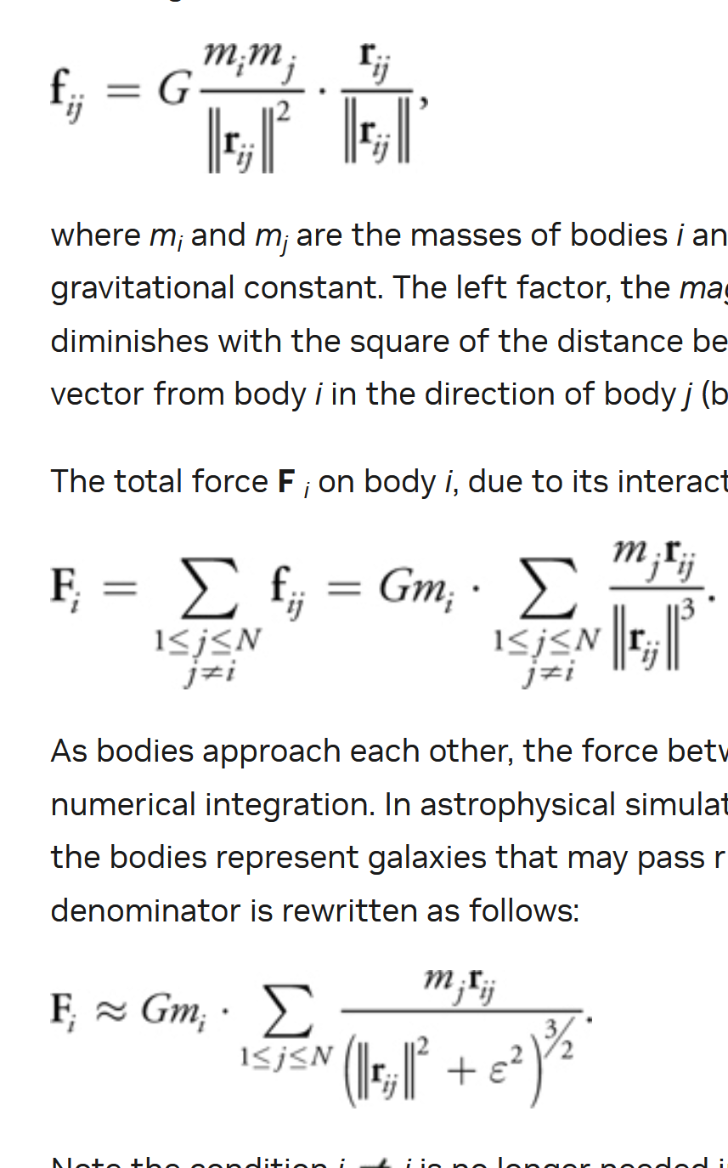
Physics for Stellar Systems
Explain gravitational interaction (mostly from “31.2 All-Pairs N-Body Simulation
“ Gem3)
And explain softening factor

Slide 5
Interaction Methods
All-pairs method
Barent-hut?
Other? (see nvida gem3 bottom)

Slide 6
Position Integration Methods
Euler method
Leapfrog
Verlet
(Leapfrog or Verlet first)?

Slide 7
Nvidia’s N-Body Algorithm
Explain NxN matrix and tiling of said matrix in general just explaining nvidias gem3

Slide 8
Code Samples
Pics of nvidas kernel and device functions some explanations
Some information on self written code, how these functions where implemented in own code

Slide 9
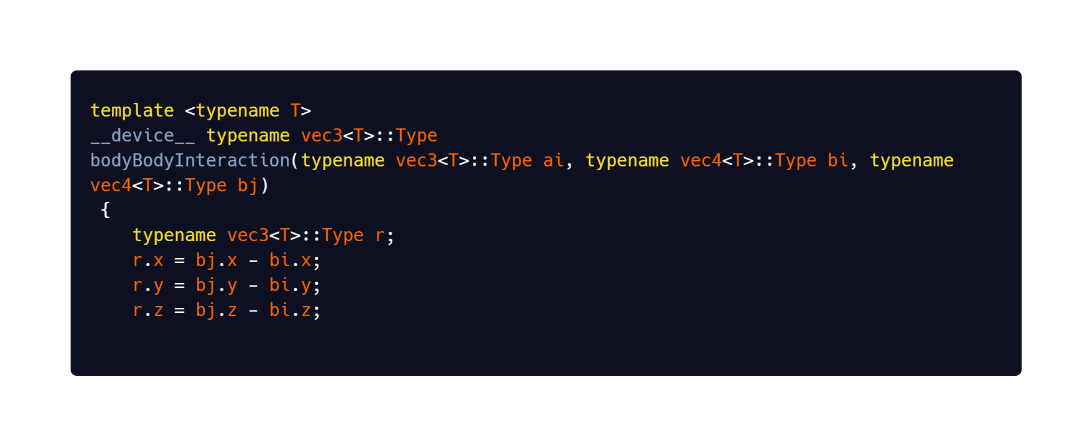
How does the NVIDIA code works?
First we need to calculate the acceleration :

Slide 10
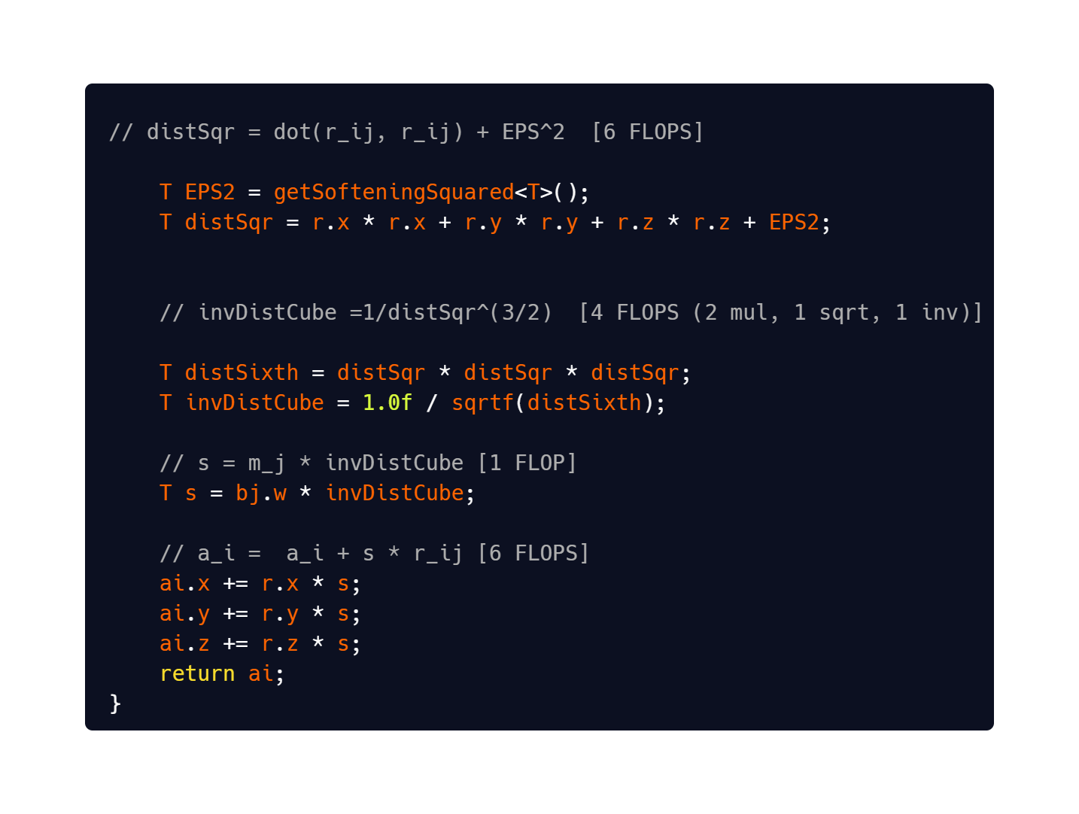
How does the NVIDIA code works?
First we need to calculate the acceleration :

Slide 12
Performance
Nvidia provides a code to measure the performance of the n-body simulation
There are two parameters:
Time for 10 interactions
GFLOPs per second (Each interaction has 20 Flops)

Slide 13
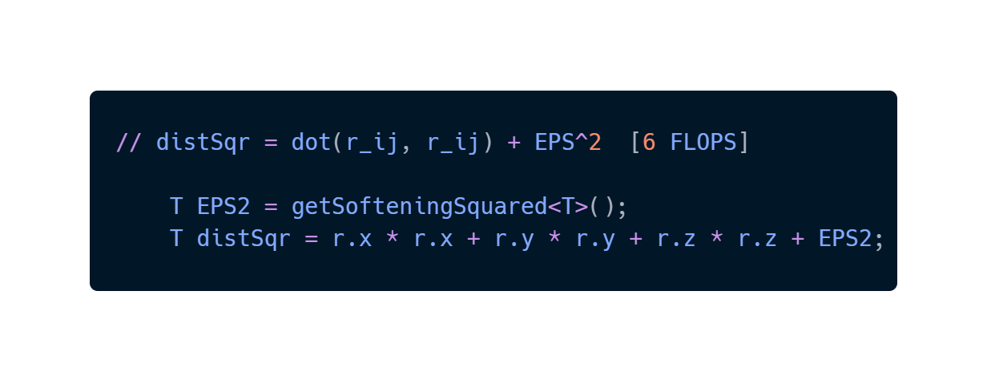
WTF is a FLOP ?
A Flop is a funny Name for an operation, for example: a multiplication, a sum, a root squared

Slide 14
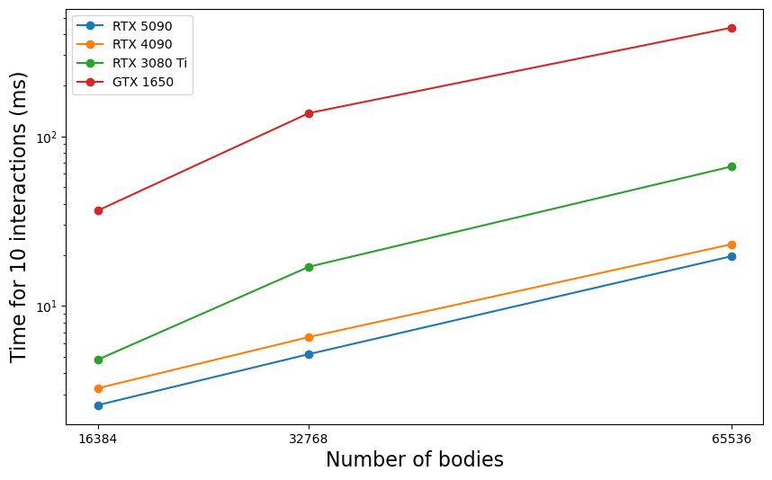
Performance comparison between GPUs

Slide 15
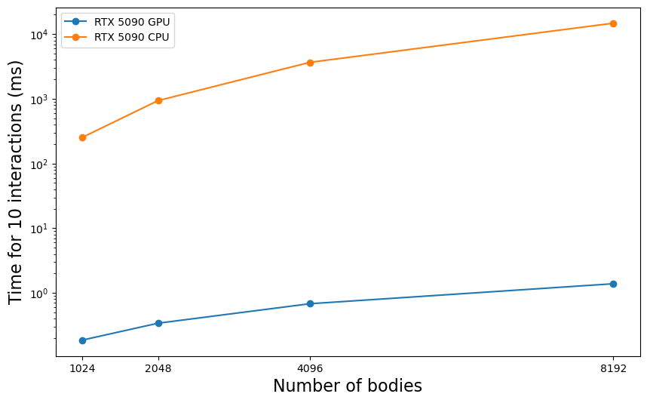
Performance comparison between GPU and CPU 5090

Slide 16
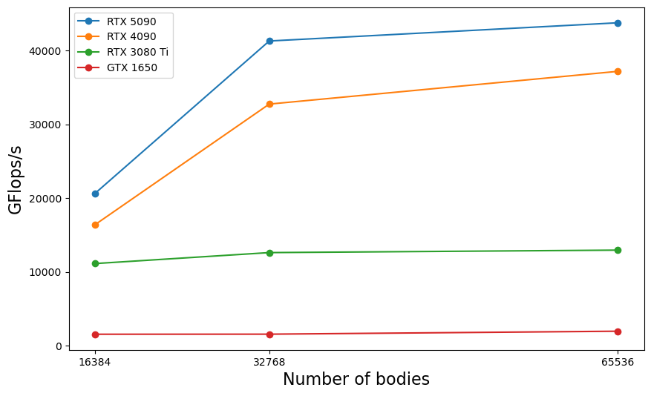
Performance comparison between GPUs in GFLOPs

Slide 17
Visual Examples
Some videos of nvidia visualization how it could look like

Slide 18
Farben
Als erstes soll mit schwarz und weiß gearbeitet werden. Für Aufwändigere Darstellungen sind Farben mit Bedacht und in möglichst geringem Umfang einzusetzen. In diesem Folienmaster ist die Farbpalette festgelegt.
Zuerst mit den Primärfarben arbeiten.
Für z.B. komplexe Diagramme stehen noch Sekundärfarben zur Verfügung.
Gering im Einsatz sind die Akzentfarben.

Slide 19
References
[1] https://developer.nvidia.com/gpugems/gpugems3/part-v-physics-simulation/chapter-31-fast-n-body-simulation-cuda

